Slide 1


Mind Sending
Supervisor: - Lam Huu Khanh Phuong
Members: - Ngo Minh Tan - Leader
- Nguyen Huu Thang
- Nguyen Luu Hong Son

Slide 2
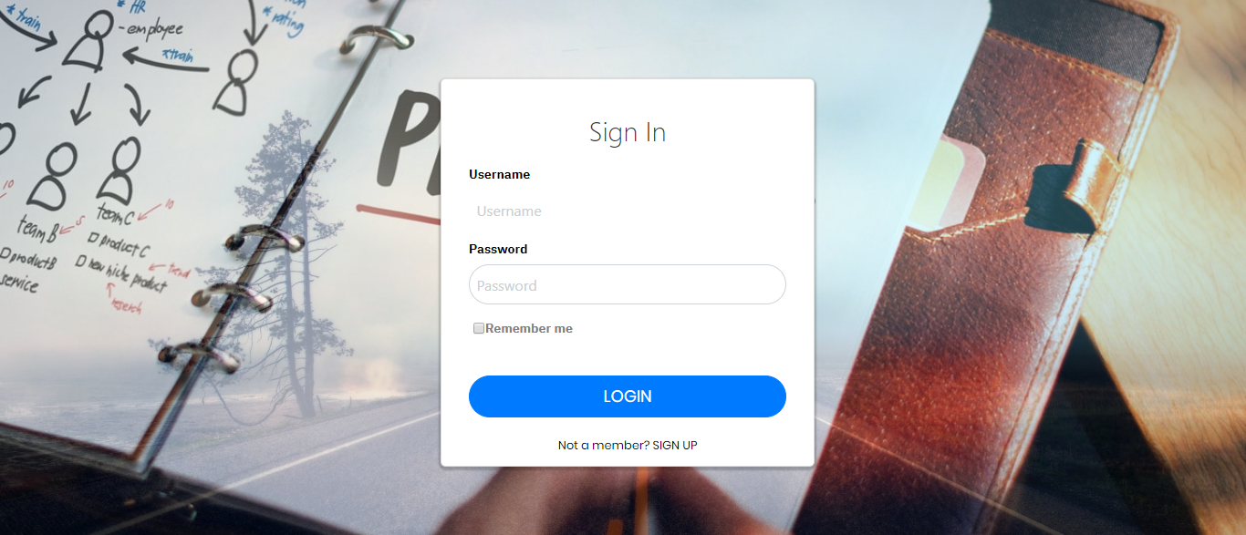
01
Introduction
02
Issues
03
CONTENT
Idea & Solution
04
algorithm
05
Outcome
06
Future Plan
07
Q & A

Slide 3

1. Introduction
What?
Why?
How?

Slide 4

1. Introduction
What?
Why?
How?

Slide 5
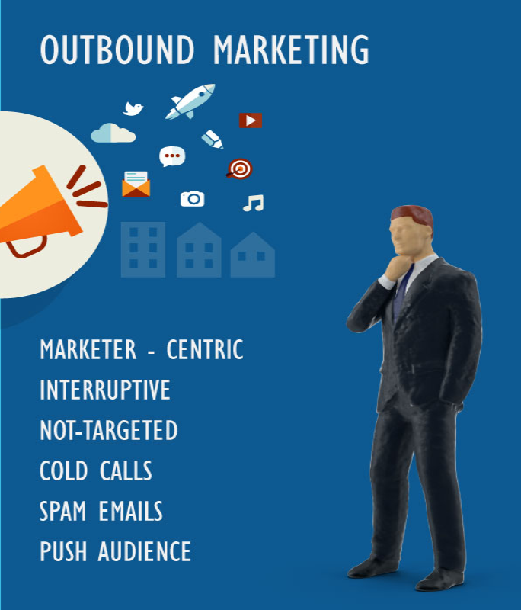
1. Introduction
What?
Why?
How?

Slide 6
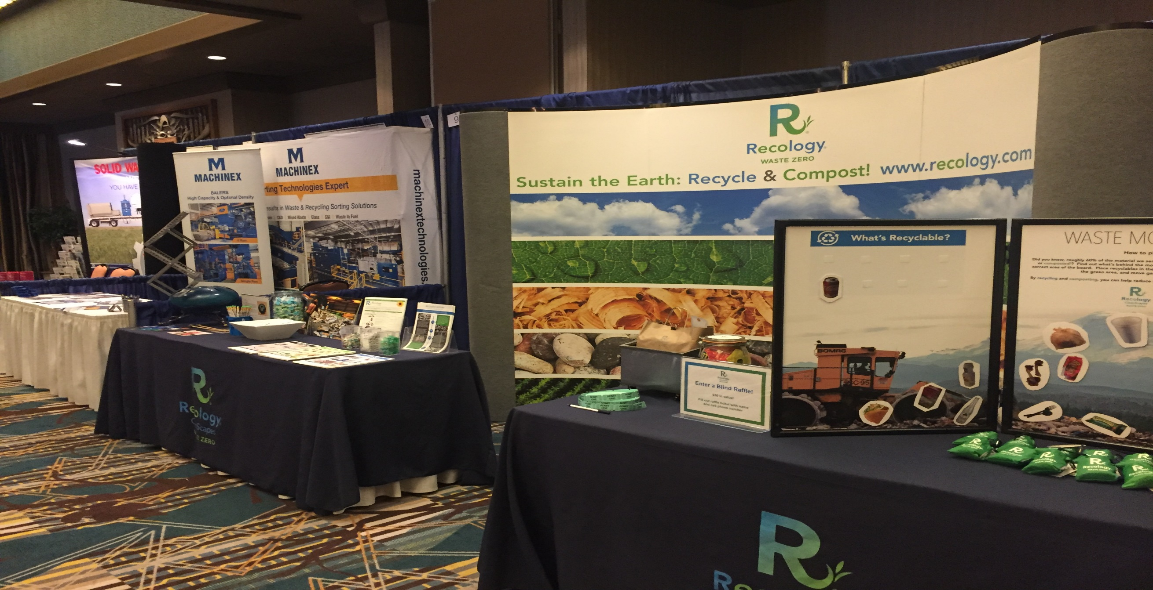
1. Introduction

Slide 7

1. Introduction

Slide 8

1. Introduction
Kiếm hình áp đặt thông tin.

Slide 9
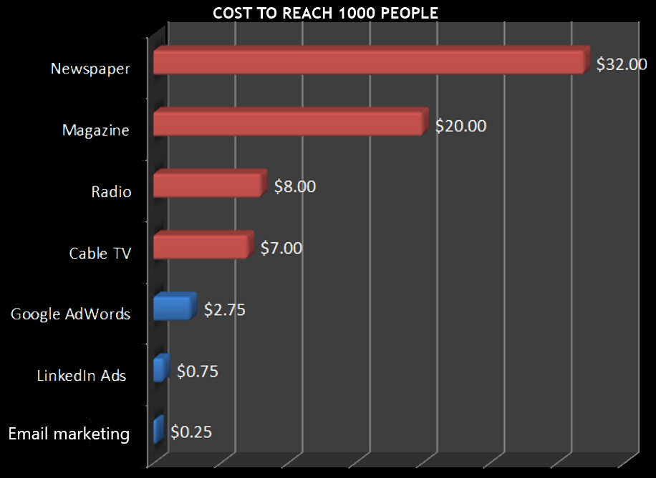
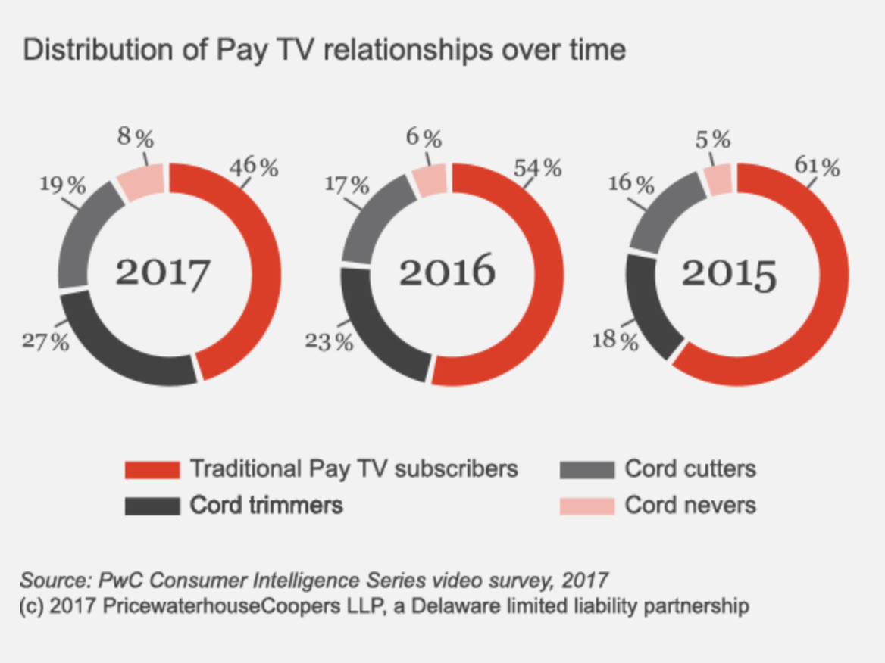
1. Introduction

Slide 10

1. Introduction
What?
Why?
How?

Slide 11
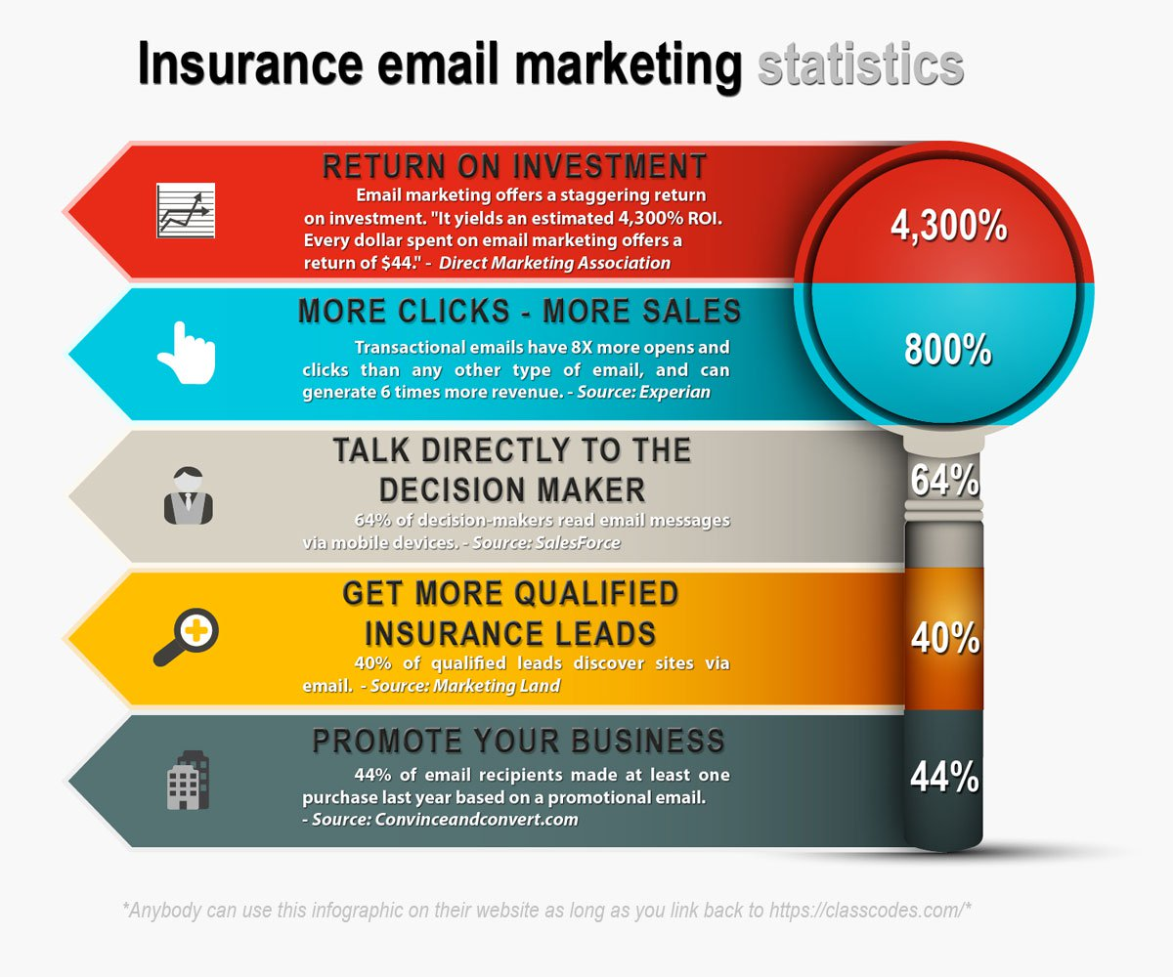
1. Introduction
What?
Why?
How?

Slide 12
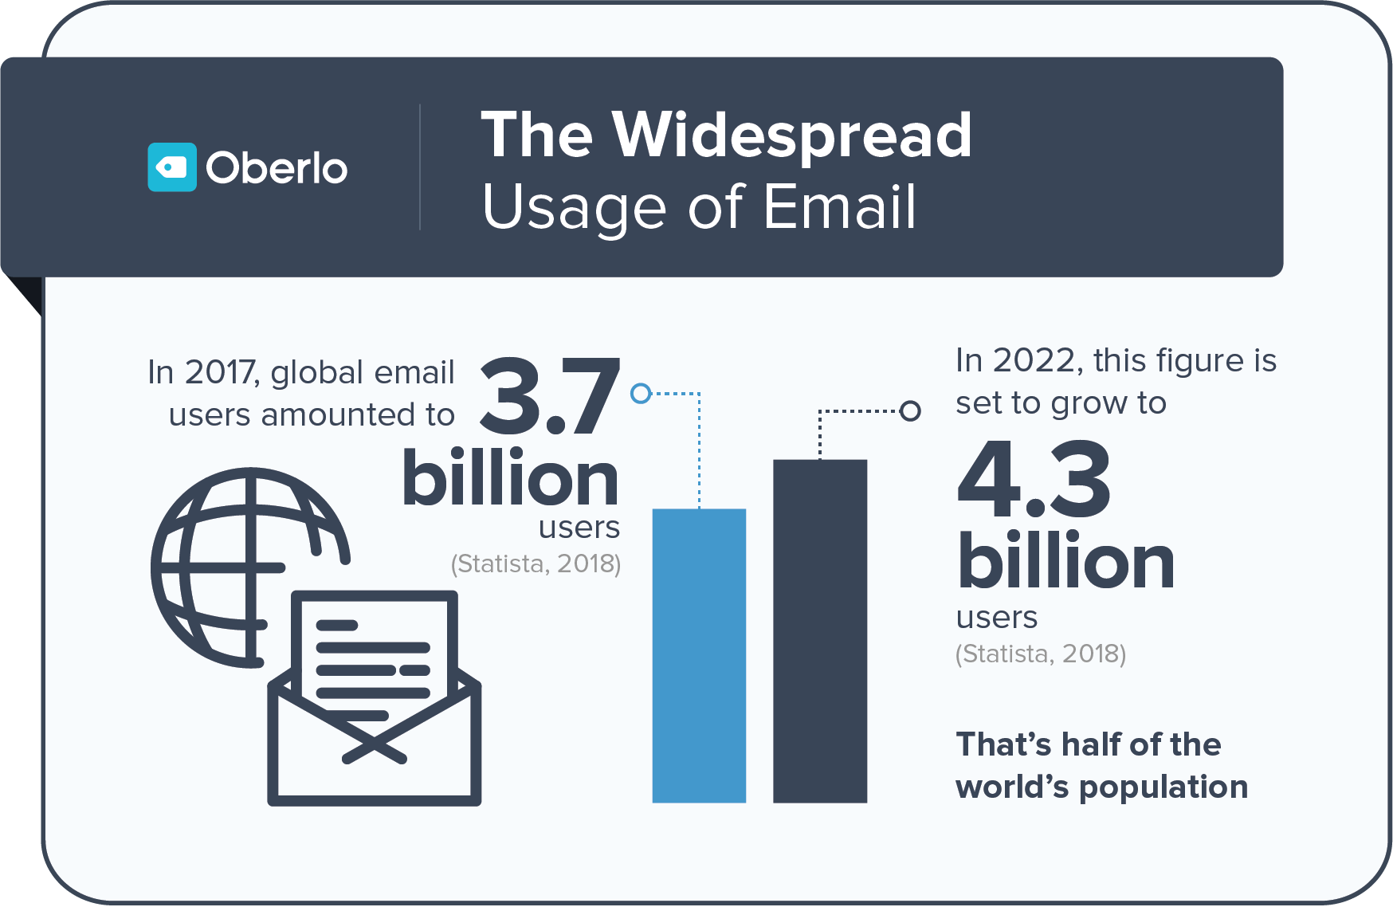
1. Introduction

Slide 13

Email marketing
Minimize the cost

Slide 14

Email marketing
High success rate

Slide 15

Email marketing
High speed and easy to use

Slide 16

Email marketing
Aim for the right target

Slide 17

Email marketing
Flexibility in design

Slide 18

Email marketing
Increase brand awareness and keep relationships with customers

Slide 19

2. Demo
20

Slide 20

2. Issues
Control big data of contacts
High Spam Rate
High Cost
4. Block Email Sender

Slide 21


Issue
Can not control amount of customers

Slide 22

Issue
Not guarantee user’s mail will be in customer’s inbox

Slide 23

Issue
Block email

Slide 24

Issue
High Cost

Slide 25
2. Issues
Control big data of contacts
High Spam Rate
High Cost
4. Block Email Sender

Slide 26
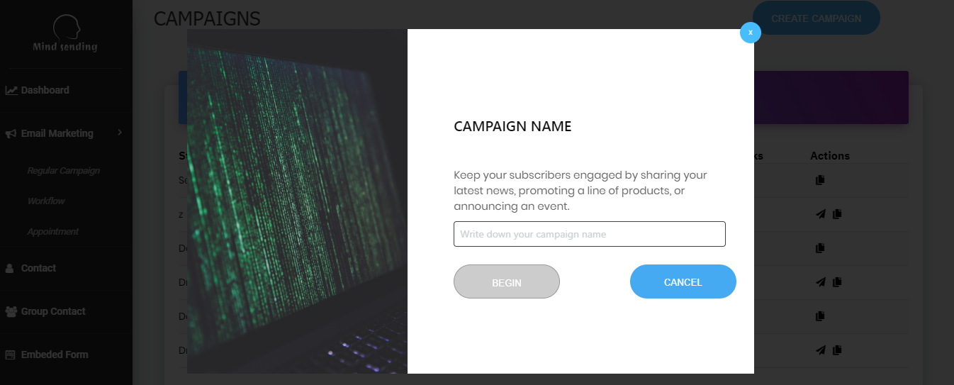
3. Idea & Solution
What?
Why?
How?

Slide 28
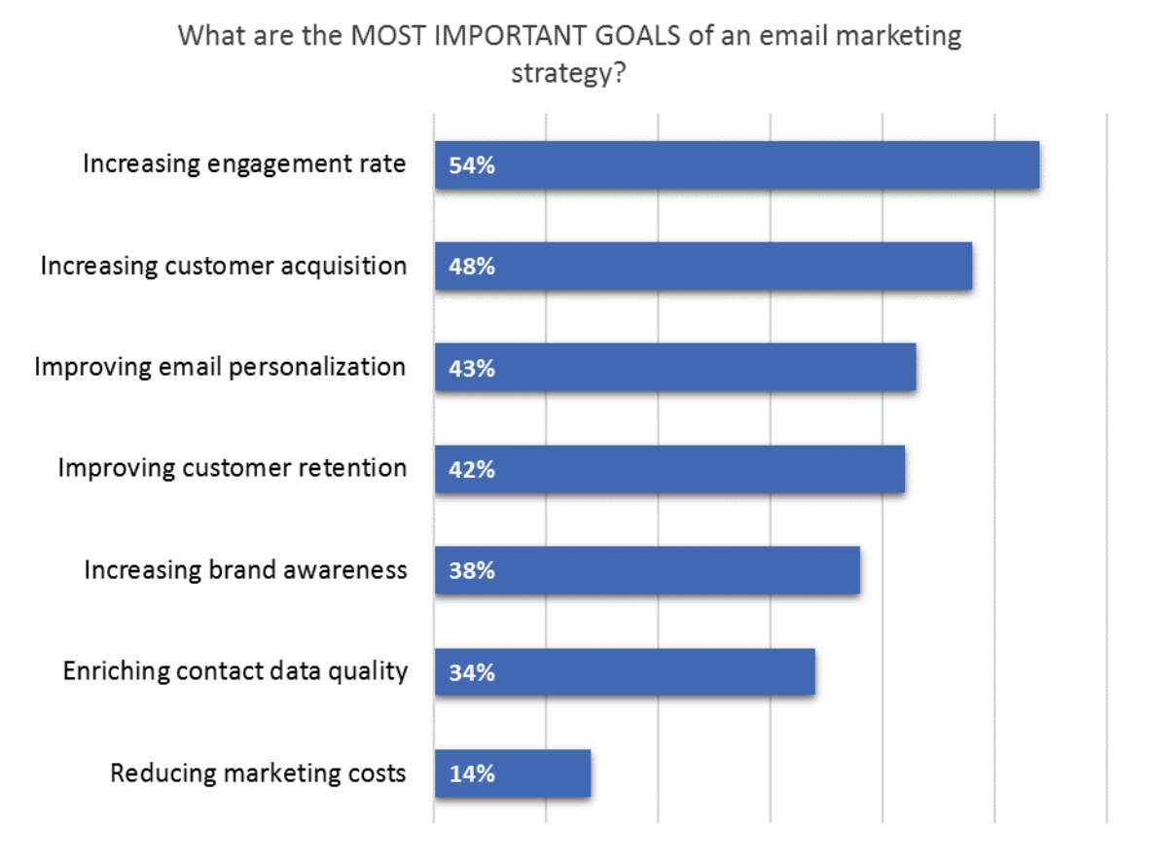
Idea & Solution

Slide 29
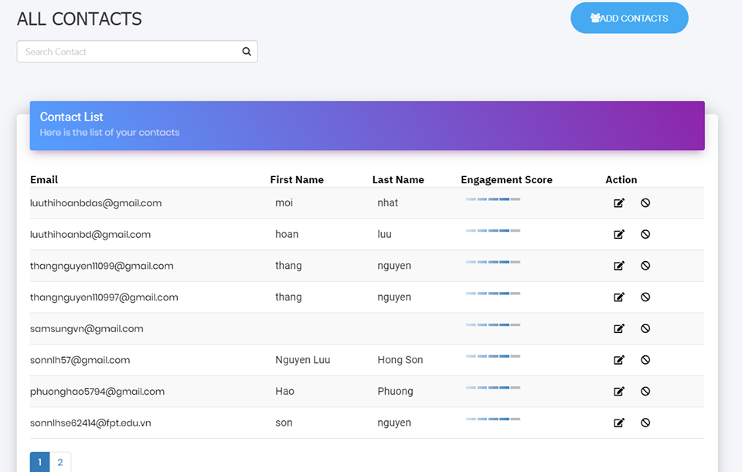
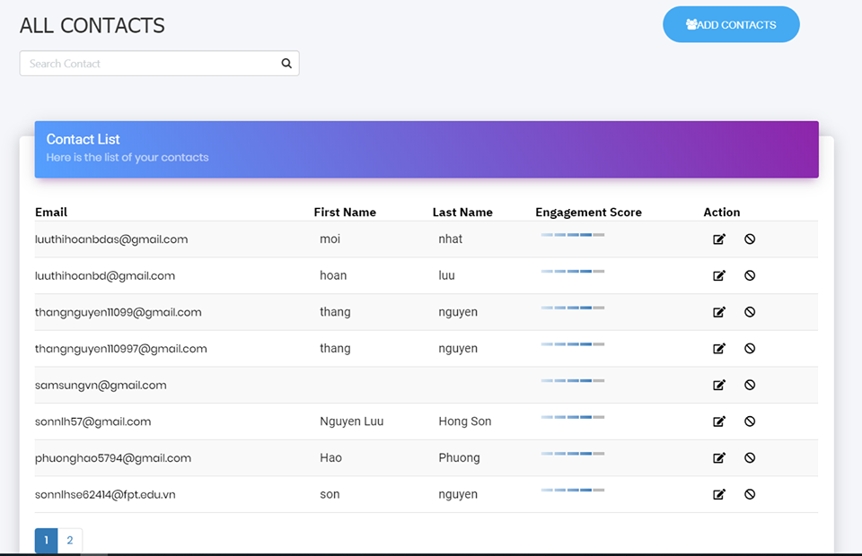
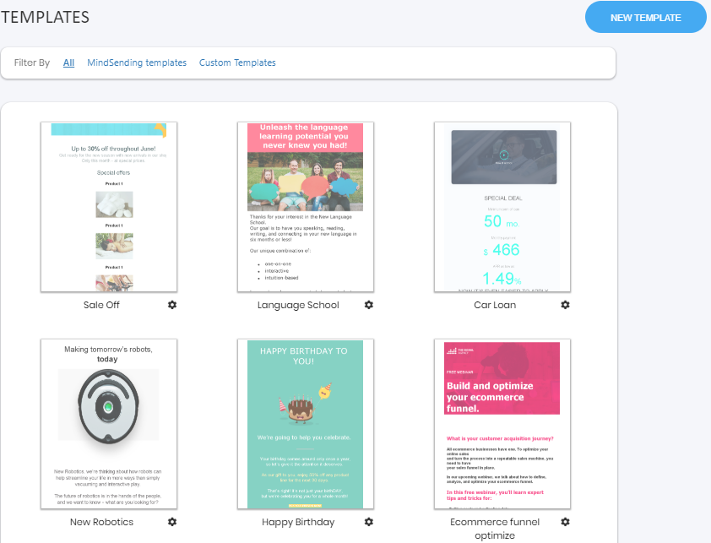
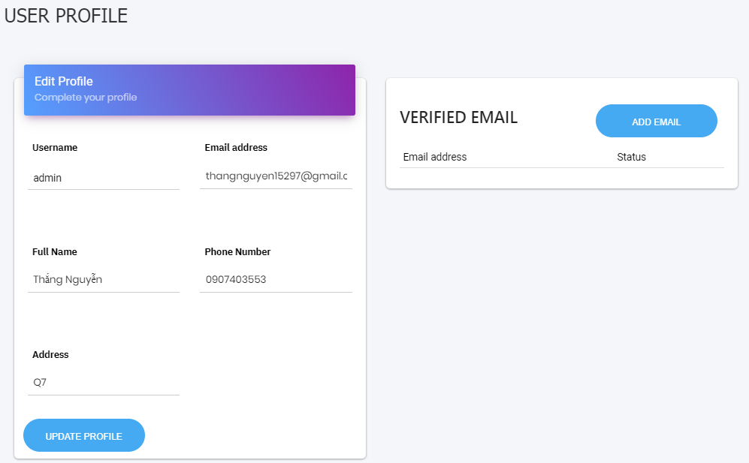





Contact
Add contact
Edit contact
View detail
Move to blacklist

Slide 30
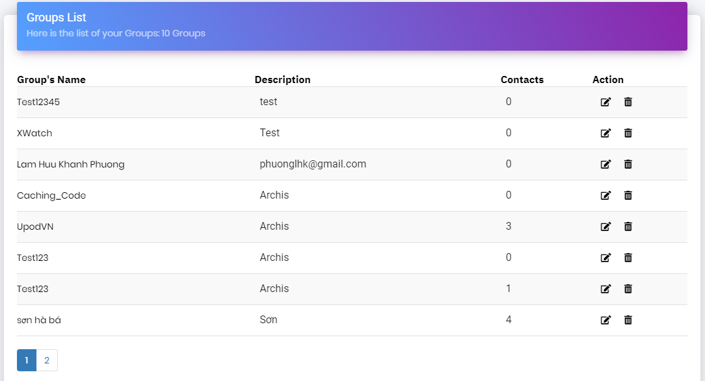
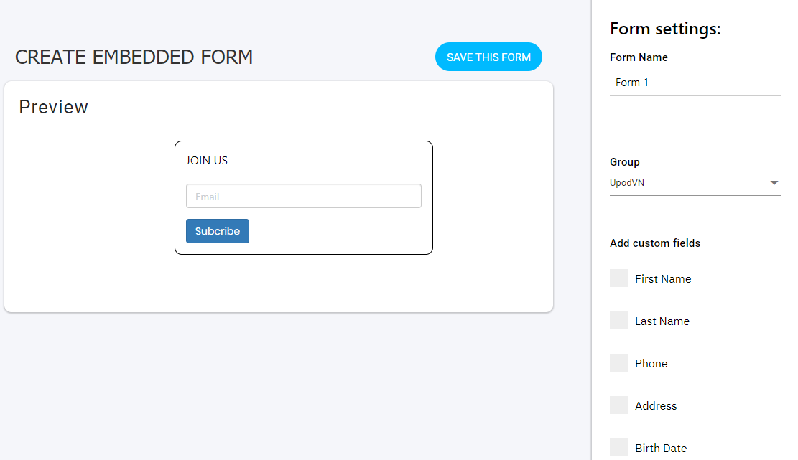
Group contact
Create group
Edit group
View detail
Create segment

Slide 31



User profile
Update profile
Add verify email

Slide 32
Template
Create template
Preview template
Edit template
Copy template

Slide 33
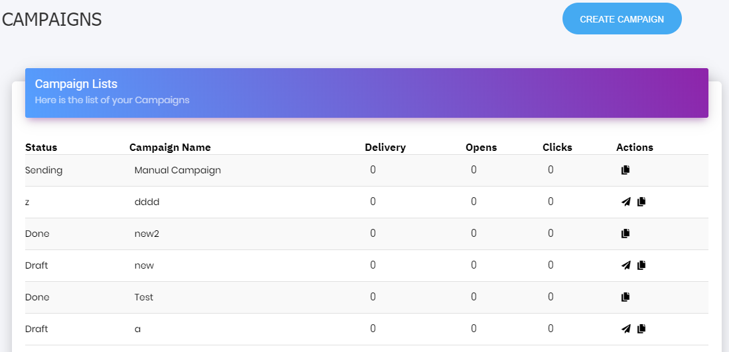
Regular campaign
Create campaign
Edit campaign
View detail
Copy campaign

Slide 34
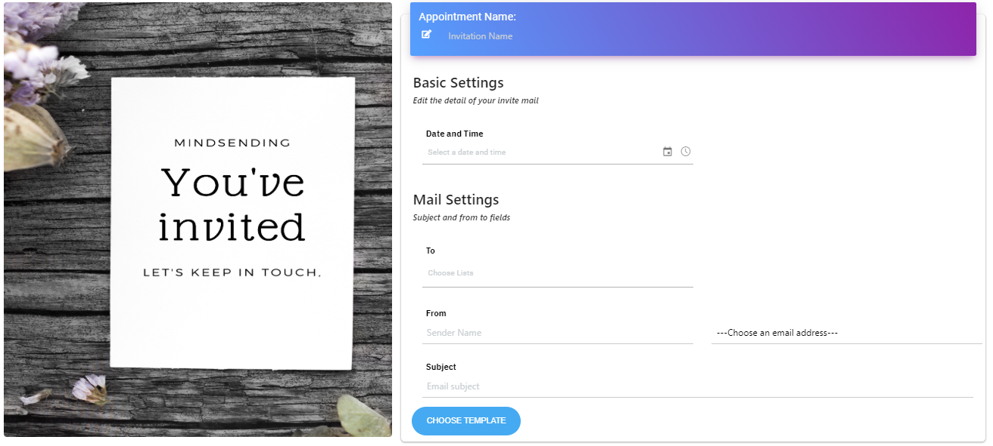
Appointment
Create appointment
Edit appointment
View detail

Slide 35
Embed form
Create form
Copy code
Preview form

Slide 36
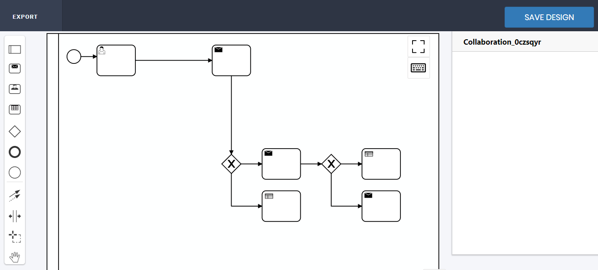
Workflow
Create workflow
View detail

Slide 37
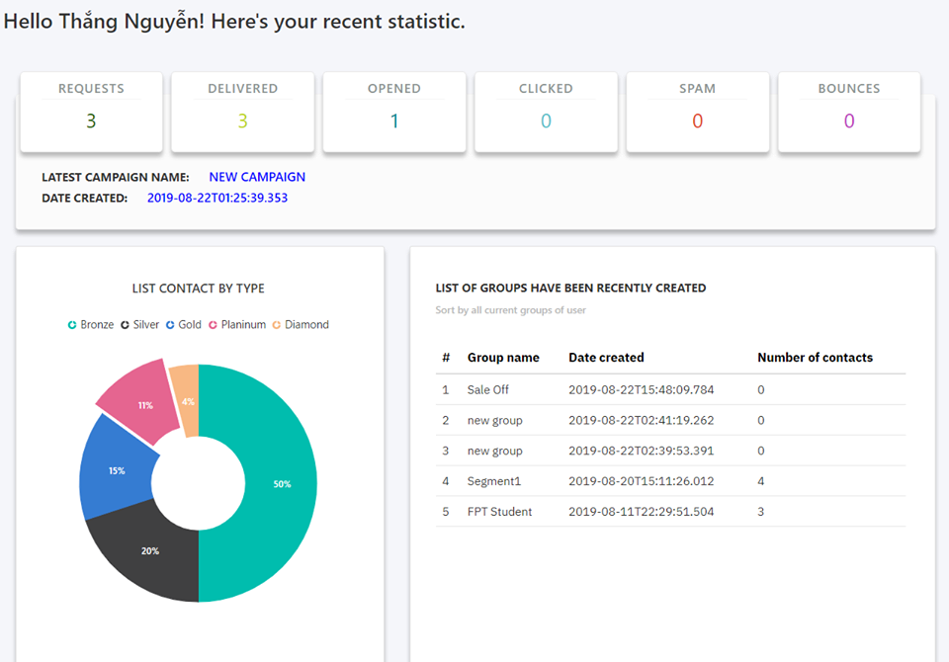
Dashboard
View detail

Slide 38

















4. Outcome

Slide 39













5. Future Plan

Slide 40




Thanks for listening!

Slide 41
Q & A

